Slide 1
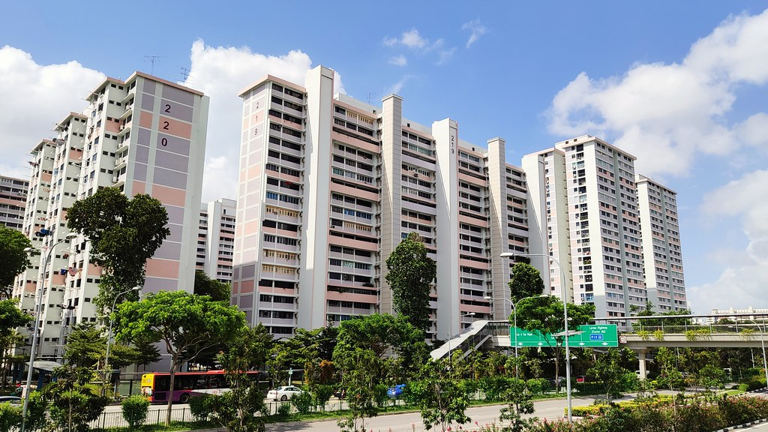
Project 3: Data Sprint
WOW!
HDB Resale Prices
By Group 1 (Priyanka, Cyril and Darrick)

Slide 2
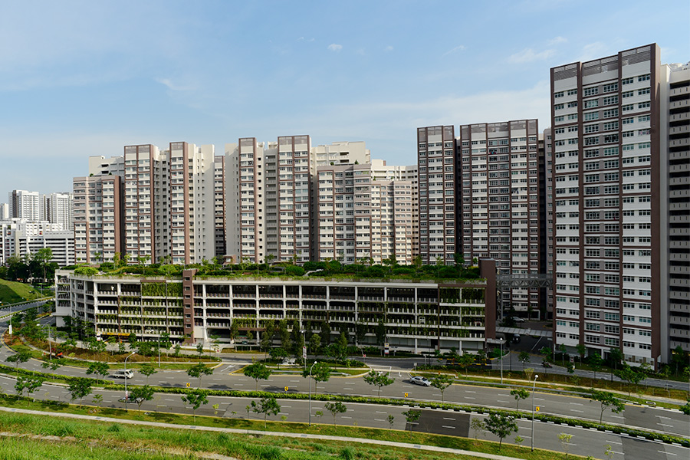
At WOW!, we understand that navigating Singapore’s competitive HDB resale market requires sharp insights and data-driven decision-making. With rising demand and volatile pricing trends, both buyers and sellers need accurate, real-time guidance to secure the best value. That’s why we’ve developed a powerful analytics tool designed to empower our agents with precise pricing intelligence.
This tool leverages advanced data modeling to analyze historical transactions, location trends, and flat attributes—enabling us to provide clients with competitive pricing recommendations tailored to their specific needs. Whether advising sellers on optimal listing prices or helping buyers identify undervalued opportunities, our solution ensures informed, strategic decisions in a fast-moving market.
By combining market expertise with cutting-edge analytics, we’re not just keeping pace with the HDB resale market—we’re setting the standard for transparency, accuracy, and trust. Let’s dive into how this tool works and the key insights it unlocks for our clients.

Slide 3
Past Trends

Slide 4
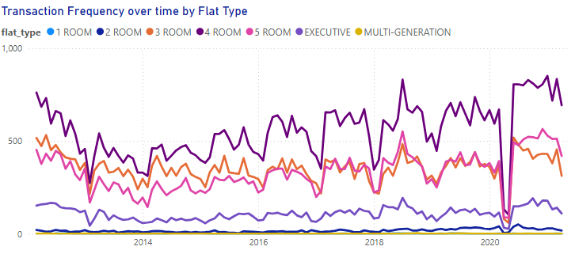
Trend Analysis of HDB Transactions
(Mar 2012 – Apr 2021)
Feb 13
Apr 20
From March 2012 to April 2021, Singapore’s HDB resale market experienced fluctuations due to policy changes and economic conditions. Overall, the market shifted from policy-driven cooling to pandemic-induced volatility before entering a sustained recovery. Key highlights;
February 2013 (Cooling Measures Impact):
After peaking in 2012, transactions declined sharply in February 2013 due to tighter loan restrictions (MSR cap, ABSD hikes, and lower LTV limits). Prices stabilized as demand softened.
April 2020 (COVID-19 Disruption):
The Circuit Breaker led to a temporary halt in physical viewings, causing a sharp drop in transactions. However, the market rebounded quickly due to pent-up demand and low-interest rates.

Slide 5
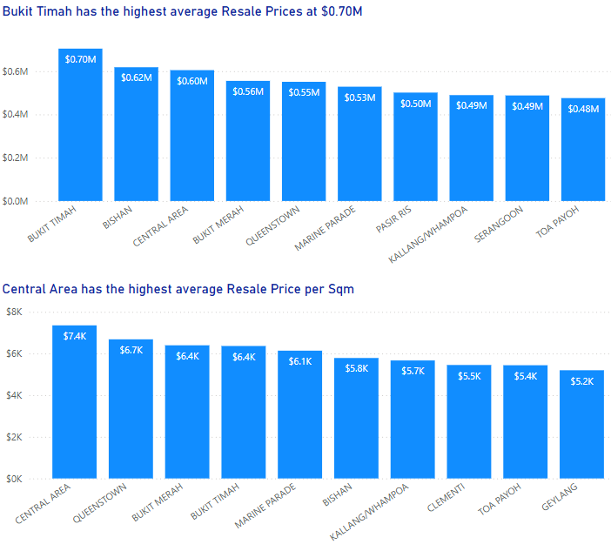
Most Expensive Towns
(Mar 2012 – Apr 2021)
Average Resale Price:
Bukit Timah shows the highest average resale price among the listed towns, with towns like Bishan and the Central Area also on the higher end.
Average Price per Sqm:
The Central Area leads in terms of price per square meter, followed by Bukit Merah, Bukit Timah, and Marine Parade. Some towns with high overall resale prices do not necessarily have the highest price per sqm.

Slide 6
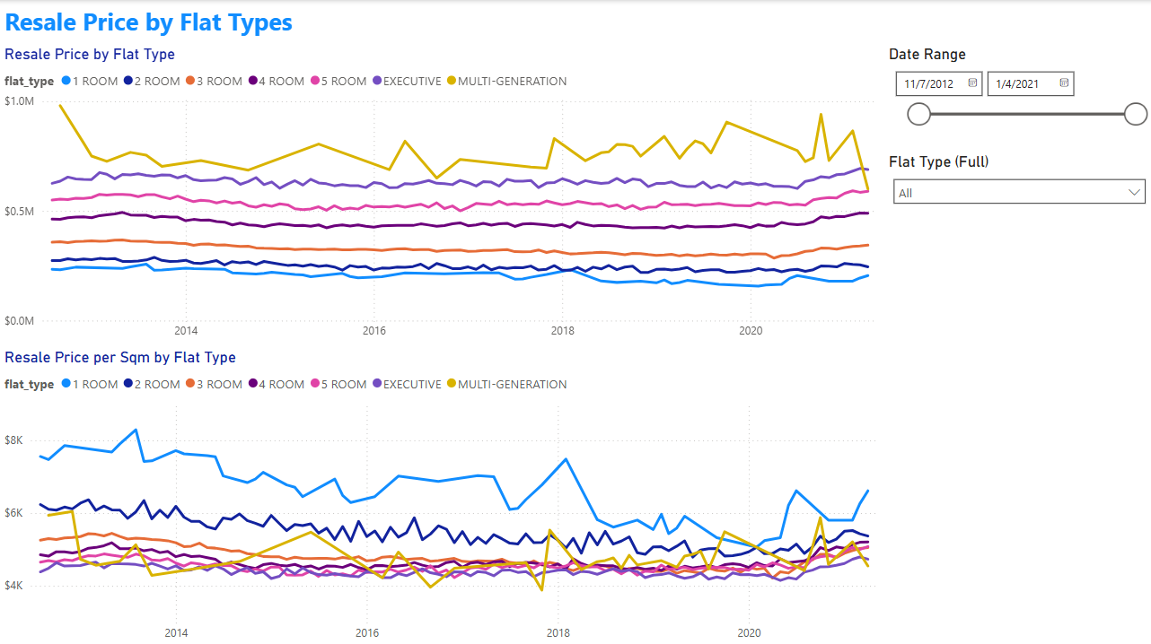
Dashboard Showcase

Slide 7
Predictive Model

Slide 8
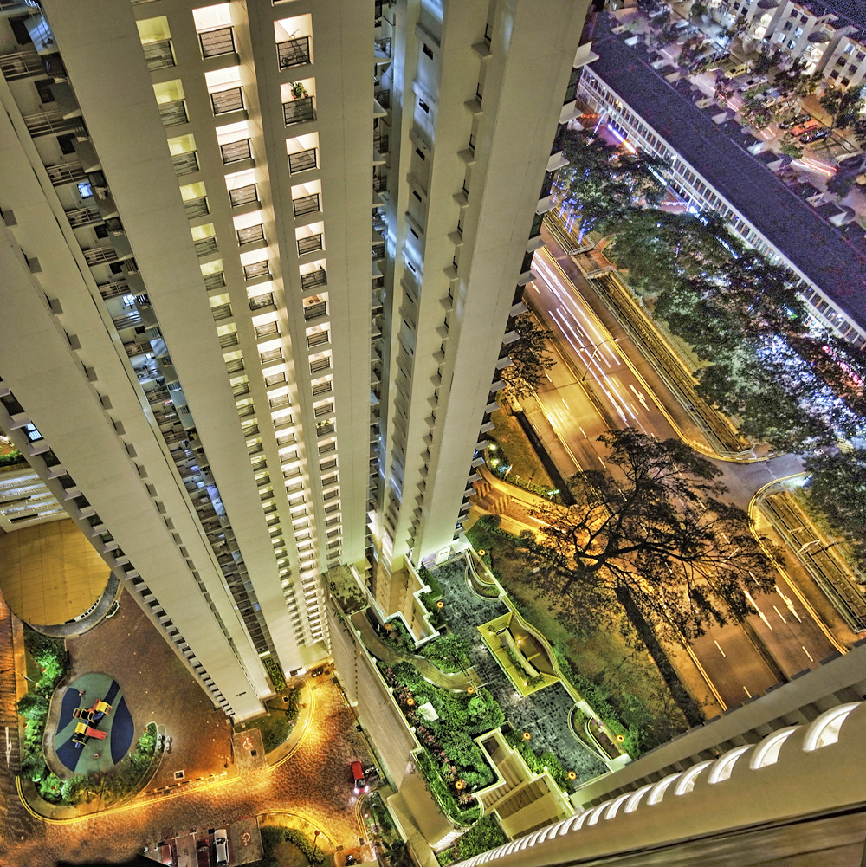
Exploratory Data Analysis & Feature Selection
Dataset Overview:
Started with an extensive dataset (originally 78 columns, 150,634 rows).
Narrowed down to 21 impactful columns relevant for accurate HDB resale valuation.
Core Selected Features Include:
Price and flat characteristics:
resale_price, floor_area_sqm, storey_range, full_flat_type, hdb_age, town.
Proximity & Accessibility:
Distances to nearest amenities like hawker centres, MRT stations, bus stops, and educational institutions (primary, secondary schools).
Reason for Feature Selection:
Features directly impact property valuation due to physical characteristics, age, locality (town), and proximity to essential amenities.
Balancing both numerical factors (like floor area, age, distances) and categorical aspects (flat type, town) ensures comprehensive value coverage.

Slide 9
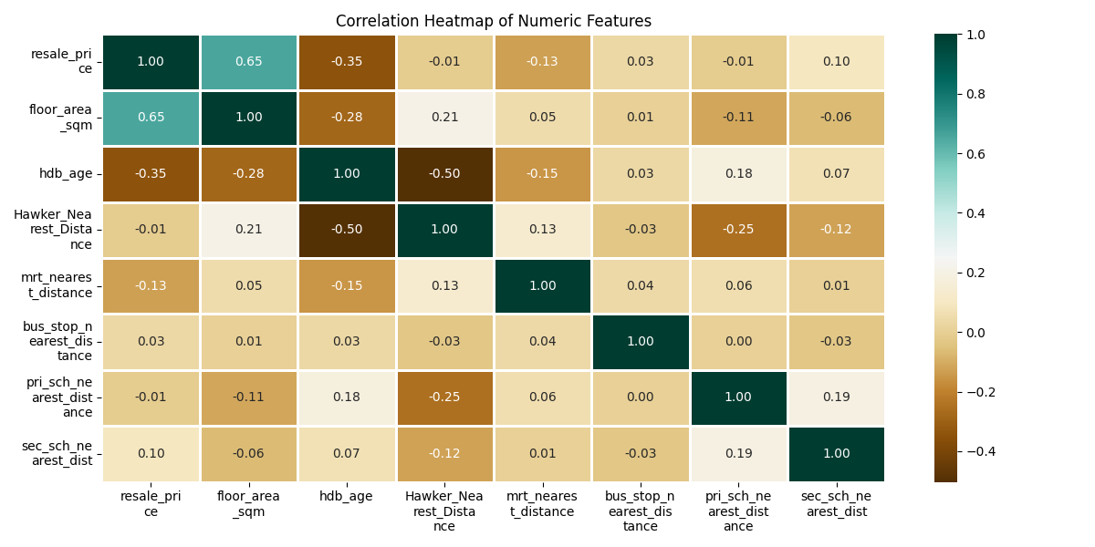
Correlation Analysis & Model Justification
Correlation Insights:
Positive correlation: Larger floor area strongly relates to higher resale prices (correlation: 0.65).
Negative correlation: Older flats (higher hdb_age) generally fetch lower prices (correlation: -0.35).
Moderate correlation: Distance to amenities (MRT, hawker centres) indicates moderate but impactful relationships.
Minimal correlation: Bus stop and schools distances show low correlation but retained to explore potential non-linear interactions.

Slide 10
Predictive Model Selection
Linear Regression
Linear regression is a simple and interpretable model, making it easy to explain pricing factors to clients. It works well when relationships between features (like floor area or lease years) and price are linear. However, it struggles with complex, non-linear patterns—such as how proximity to MRT stations or schools affects value. It’s also sensitive to outliers, which can skew predictions in a volatile market like HDB resale.
Random Forest
Random Forest excels at capturing non-linear trends and interactions between features, such as how location and flat type combine to influence price. It handles outliers well and ranks feature importance, helping agents understand key drivers like nearby amenities. While less interpretable than linear regression, it typically delivers higher accuracy, especially in markets with irregular pricing patterns.
Reasons for selecting
Random Forest
Given Singapore’s dynamic HDB resale market, Random Forest’s ability to model complex relationships outweighs linear regression’s simplicity. Prices depend on multiple interacting factors—like town, storey height, and lease decay—which Random Forest handles effectively. For accurate, competitive pricing advice, its superior performance makes it the preferred model, even if it requires more computational power.

Slide 11
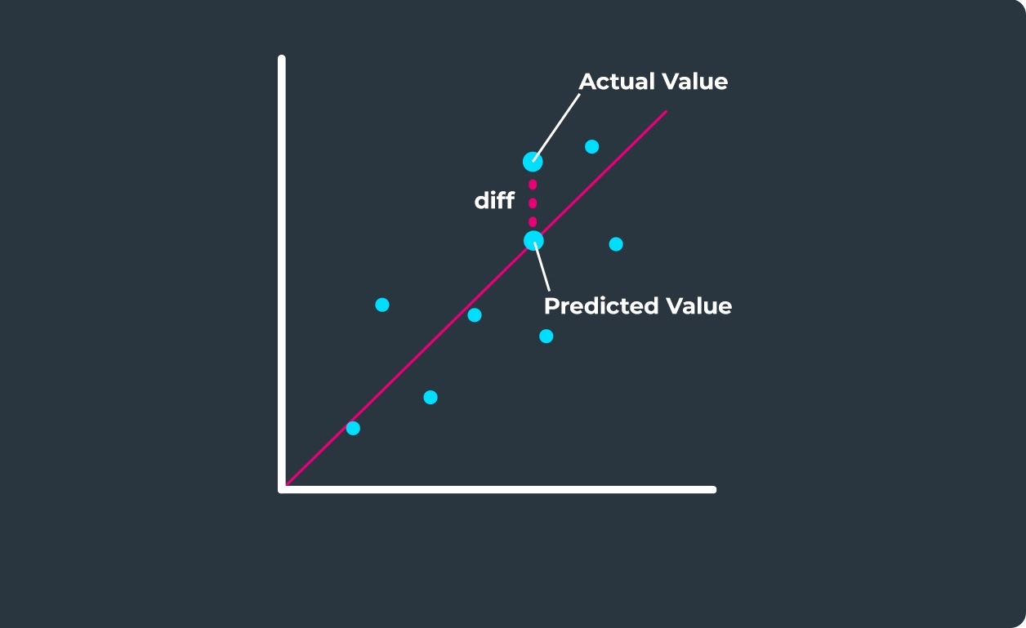
Success Matrix of Random Forest Model
What is RMSE in a Random Forest Model?
RMSE (Root Mean Squared Error) measures how far off the model’s price predictions are from actual HDB resale prices. Think of it like this: if the model predicts a flat costs 500K, but it sells for 520K, the error is $20K.
RMSE averages these errors across all predictions and gives a single number—the lower the RMSE, the more accurate the model. For home buyers and sellers, a low RMSE means the pricing advice is reliable.
RMSE of our Model = approx. $40K

Slide 12
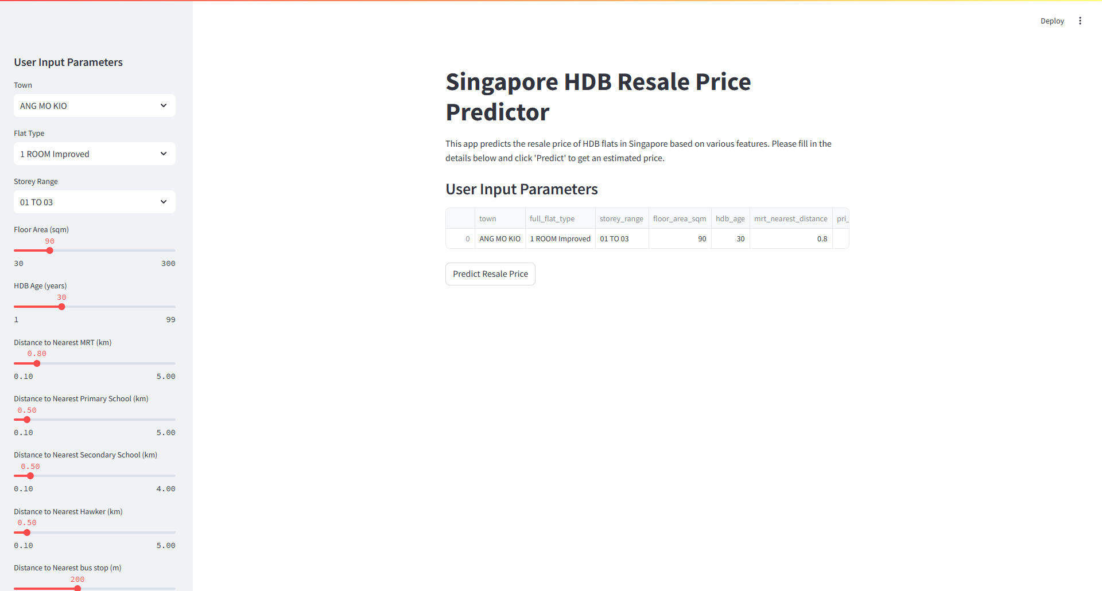
Streamlit Predictive Model Showcase

Slide 13
Limitations & Next Steps
While a 2012-2021 dataset is useful for understanding long-term trends, it does not reflect current market dynamics. To get a complete picture, supplementing with 2022-2024 data and adjusting for policy changes is essential.
The dataset ends in 2021, missing key market shifts:
Post-COVID-19 effects (e.g., increased demand for larger flats due to remote work, supply chain disruptions affecting BTO delays).
2022-2024 cooling measures (e.g., higher Additional Buyer’s Stamp Duty (ABSD), tighter loan-to-value (LTV) limits).
Recent price surges (HDB resale prices hit record highs in 2022-2023).
New housing policies (e.g., Prime Location Public Housing (PLH) model introduced in late 2021).
Policy shifts not captured:
Enhanced CPF Housing Grants (changes in eligibility and amounts).
MOP (Minimum Occupation Period) adjustments (e.g., 10-year MOP for PLH flats).
Rent restrictions (subletting rules for HDB flats).
Interest rate changes (SIBOR to SORA transition, rising mortgage rates post-2021).

Slide 14
Retrospective
(5mins)

Slide 15
Q&A
(5mins)

Slide 16
THANK YOU

